Slide 1

Planning Update
Northstowe Community Forum
9 November 2022

Slide 2
Planning Update
Phase 3A
Digital Park
Northstowe Education Campus

Slide 3
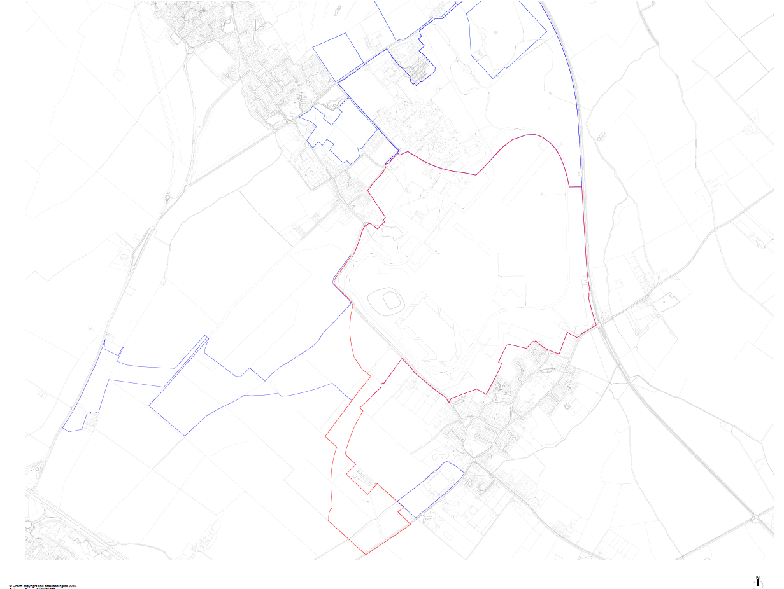
Phase 3A outline permission
Reference:
20/02171/OUT
Status:
Permission granted,
Judicial Review in progress

Slide 4
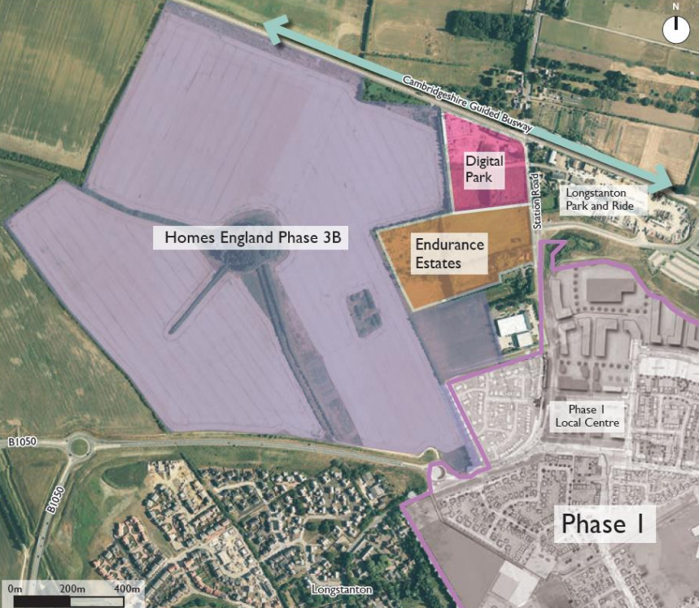
Digital Park
Reference:
S/3854/19/OL
Status:
Resolution to grant,
Finalising S106

Slide 5
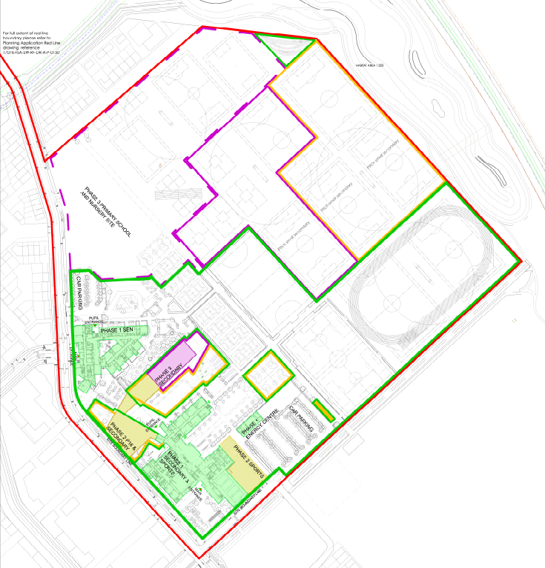
Northstowe Education Campus
Reference:
N/A
Status:
Pre-application
Phasing Plan from S/0092/18/CC

Slide 6
www.greatercambridgeplanning.org
Greater Cambridge Shared Planning: a strategic partnership between Cambridge City and South Cambridgeshire District Councils

