Slide 1
Template header
Northstowe Community Forum
Wednesday 11 January 2023
David Parke
Associate Director for Primary Care

Slide 2

Health Care for Northstowe
Interim healthcare
Future healthcare
Health access now

Slide 3
Health Care for Northstowe
Willingham & Longstanton Medical Practice
Two sites c.11,000 registered patients Cambridge Northern Villages PCN (8 Practices, c.44,000 pts: Cottenham, Firs House, Maple Surgery, Milton Surgery, Over Surgery, Swavesey Surgery, Waterbeach Surgery and Willingham MP). Registered 2,504 patients from Northstowe to date Two week turnaround for registering new patients Patient acuity high Staff sickness Enhanced Access: 44 hours per week (evenings and weekends) across PCN, delivered by Cambs GP Network, across 8 Hub sites. Winter Support Package: ARRS additions to free up clinical time, via GPA, Digital Leads, ANP, NA and CP. Freeing up contractual pressures for GPs via QOF and LES. Surge Capacity via Feds and Hospital Trusts support (e.g. 14 day prescriptions).
Health Access Now

Slide 4
Health Care for Northstowe
Willingham & Longstanton Medical Practice
Capacity to take a further c. 5,500 patients. Workforce and operational hours to increase as necessary. Interim Community Space: location for Pathfinder Way, opposite the Green. Working with A R Urbanism and SCDC in the design and occupations of this space from Summer 2023 (to include assembly rooms, offices, food bank with café/kitchen facilities, NHS room). Working on procurement and contracting options for newly commissioned permanent facility. Heath and Wellbeing services to be co-located from both statutory and non-statutory services, working with System Partners from CUH, CPFT, CCS, LA, EEAST etc.
Interim Healthcare
Future Health Care

Slide 5
Health Care for Northstowe
Willingham & Longstanton Medical Practice
Plans to deliver a total of 1,740 sqm for a Civic Hub (1,300 GMS, Community Trusts 200, Pharmacy 120 and Dentistry 120) during Phase 2 of construction. Working to different timelines and costs of construction and how healthcare is delivered. PCNs and INs to collaborate. The Civic Hub needs to be flexible to accommodate both traditional healthcare and services that address the wider determinants of health (e.g. CAB, housing, social care, family hub, social prescribing, Public Health initiatives, social groups, leisure and active pursuits etc). More integration to deliver services closer to where people live (diagnostics, OPA, minor surgery, specialist treatments etc.). Workforce models to allow portfolio roles between Trusts, LA and PC.
Future Healthcare

Slide 6
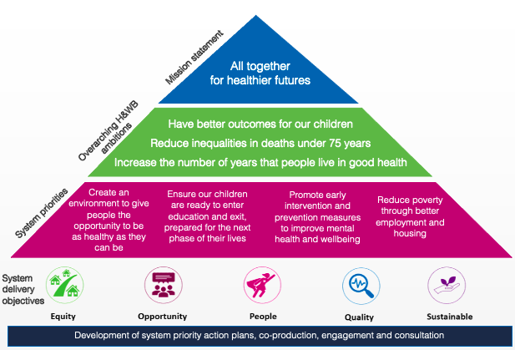
Local Context
Our Primary Care Strategy, directly supports the ICS System Strategy
ICS Primary Care Strategy
Cambridgeshire and Peterborough
ICS System Strategy (overview)
Primary Care delivery priorities:
Increase access to Primary Care
Develop and agree a sustainability model
Embed integrated neighbourhood teams
Principles underpinning Our Primary Care Strategy
Honesty and inclusivity
Appropriate Workforce
New ways of working
Maximise pandemic learning
Partnership working
Effective use of resources
Equitable service provision
Reduce health inequalities
Smart spending

Slide 7







Local Context
How will we achieve our ambition for the Primary Care Strategy
Invest in our workforce
Deliver a sustainable and robust Primary Care model,
underpinned by digital technologies, effective use of resources, PHM approach and addressing health inequalities
Define and deliver General Practice “at scale”
Improve UEC and build community care capacity
Improve timely access to primary care
maximising impact of investment by driving integrated working at neighbourhood and place level
Maintain continuity of care for patients with LTC and other complexities
Improve mental health and neurodiversity services

Slide 8
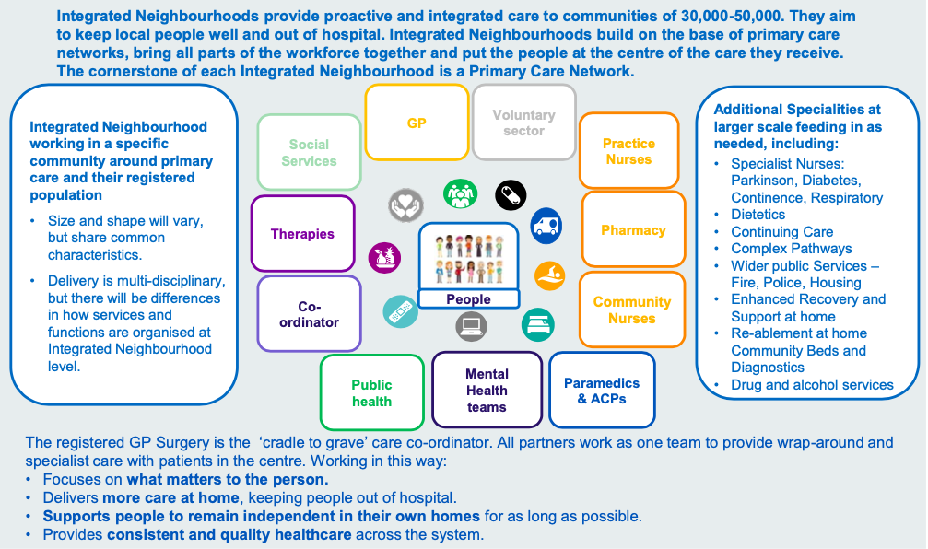
Local Context
How do we use our principles for Integrated neighbourhoods, to develop existing foundations
Embed integrated neighbourhood teams
Characteristics of Integrated Neighbourhoods
Integrated Neighbourhoods development principles
North & South Alliances to lead integrated neighbourhood development
Integrated Neighbourhoods will develop local models of integrated care with primary care networks
Independent contractor status of Primary Care will remain unaffected
Each Alliance will develop and tailor the approach to implementation
Alliances will work with Primary Care Networks (PCNs) as the key leaders and drivers of change
Integrated Neighbourhood approach will go beyond traditional Health and Social Care organisations
Alliances will learn from national lessons on the principles for implementing new care models

Slide 9
Questions

