Slide 1
Northstowe Temporary Community Centre

Slide 2
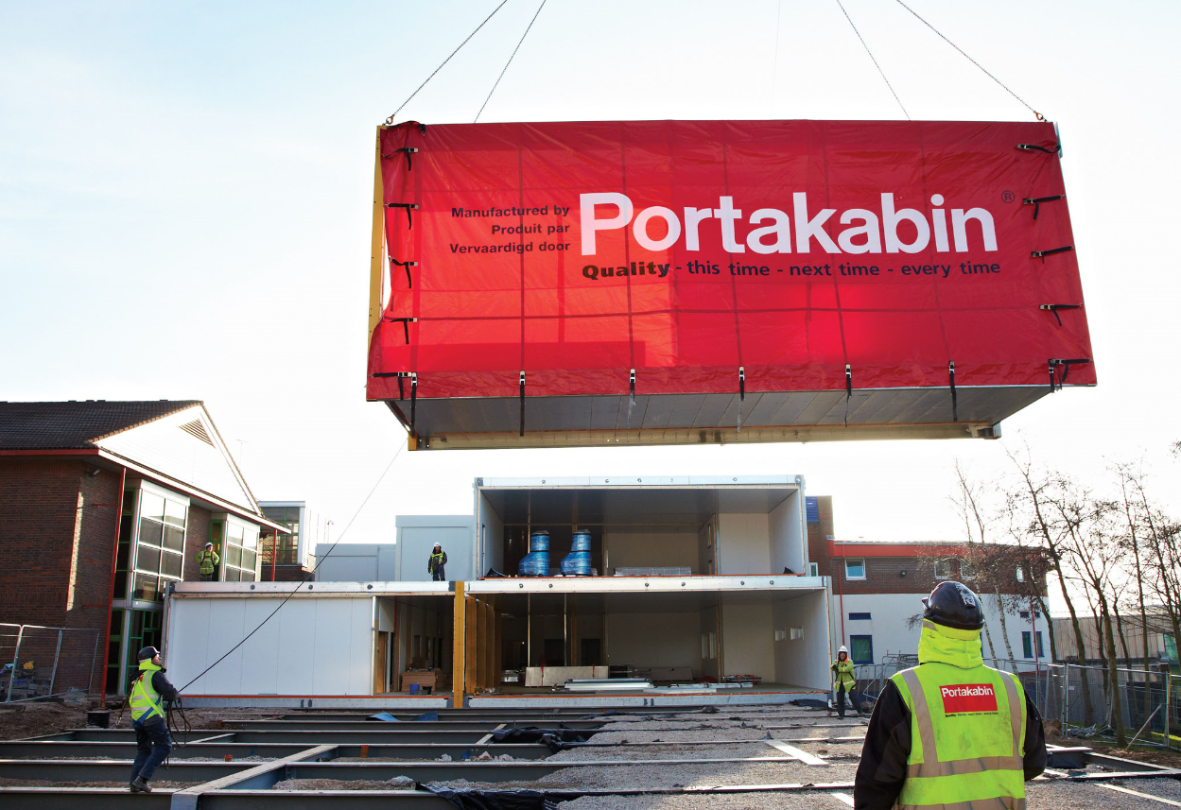
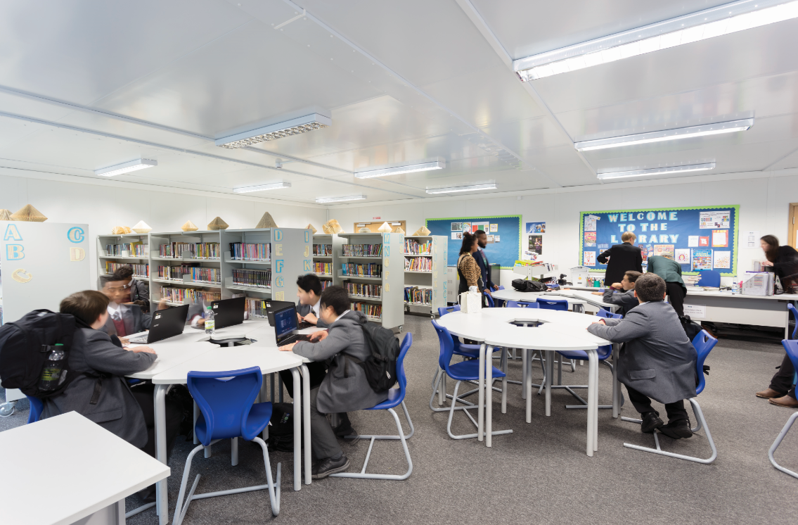
General building specification
General Portakabin Specification
External Walls - External walls consist of an insulated composite wall panel and an internal wall lining, with a cavity between, in the Portakabin Ltd colour of ‘Goosewing Grey’. The cavity between the outer insulated panel and the inner lining accommodates the columns of the structural frame. The standard performance of Portakabin Ltd Ultima Module wall construction has 60 minutes resistance to fire from In to Out and 30 minutes from Out to In.
Floors - Comprise 18 mm thick, moisture-resistant structural particle board type P5 to BS EN 312 : 2003 fixed to the galvanized steel joists with adhesive and zinc-plated screws. The floor is completely underdrawn and insulated with rigid, HCFC-free, urethane foam boards with foil facings on both sides. Standard floor to ceiling height is 2.6m.
Roof - Outstanding insulation is provided by the innovative warm deck construction of the roof. The roof deck is of a one-piece 229mm thick insulated construction covered externally with profiled, plastisol-coated galvanized steel, with solar reflective finish to reduce heat gain and provide long maintenance life. Internally, the roof panel has a galvanized steel soffit which provides a low-maintenance finish. The roof is designed to support a uniformly distributed load of 0.75kN/m2, with a concentrated load of 0.9kN.
External Doors - Fully insulated, steel faced doors in aluminium frame as standard for added security with mortice cylinder lock.
Windows - Landscape PVCu frame, with trickle vents for natural ventilation. Double glazed tinted glass with one fixed middle panel complete with 'small' replace with 'a' top opening window. Two side opening windows with safety restrictors which can be overridden for easy cleaning and locking handles for added security. Integral venetian blinds throughout.

Slide 3
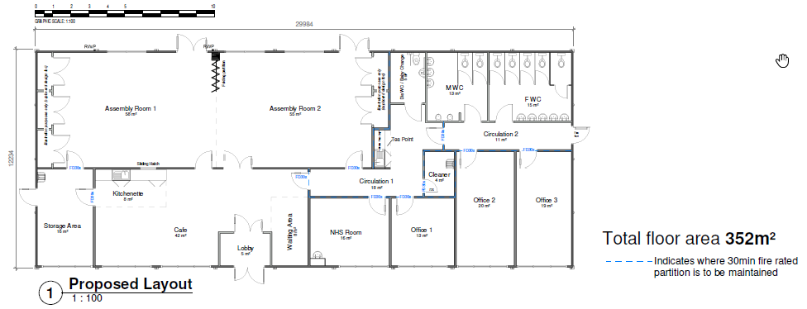
building specification

Slide 4
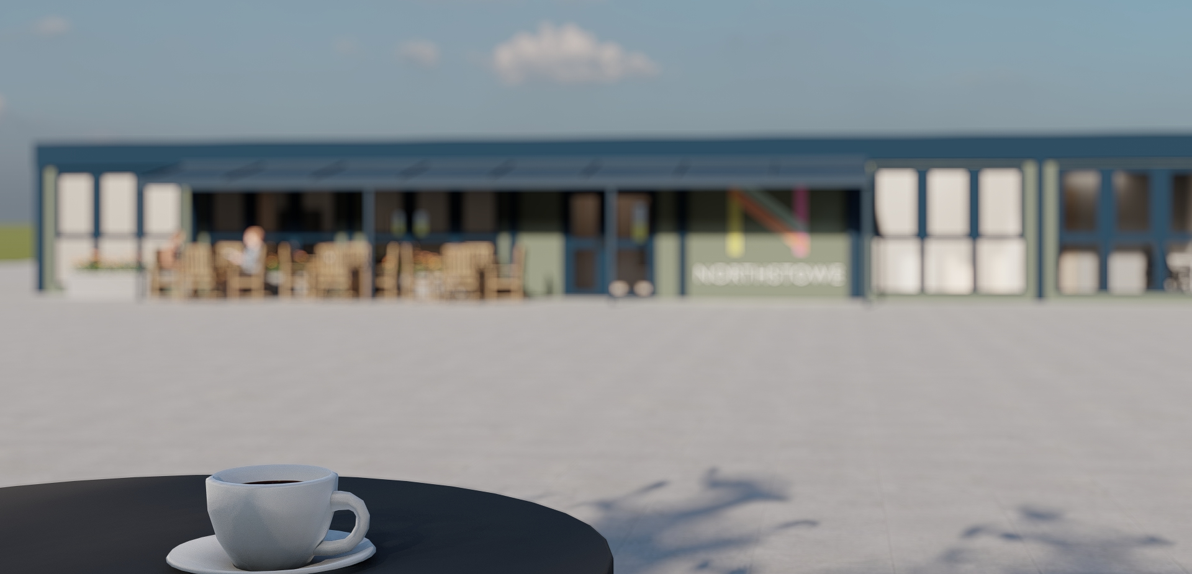
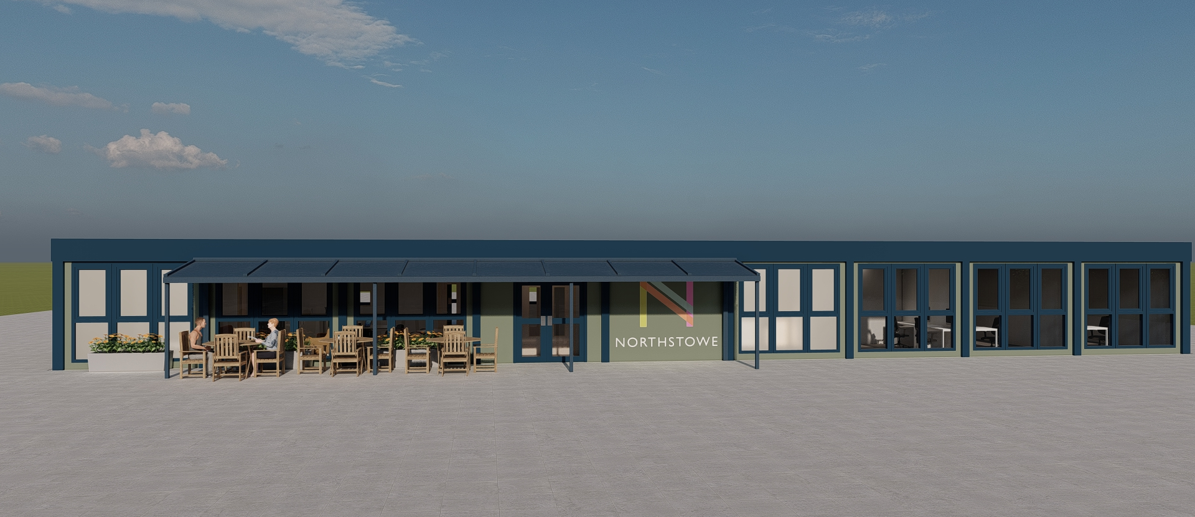
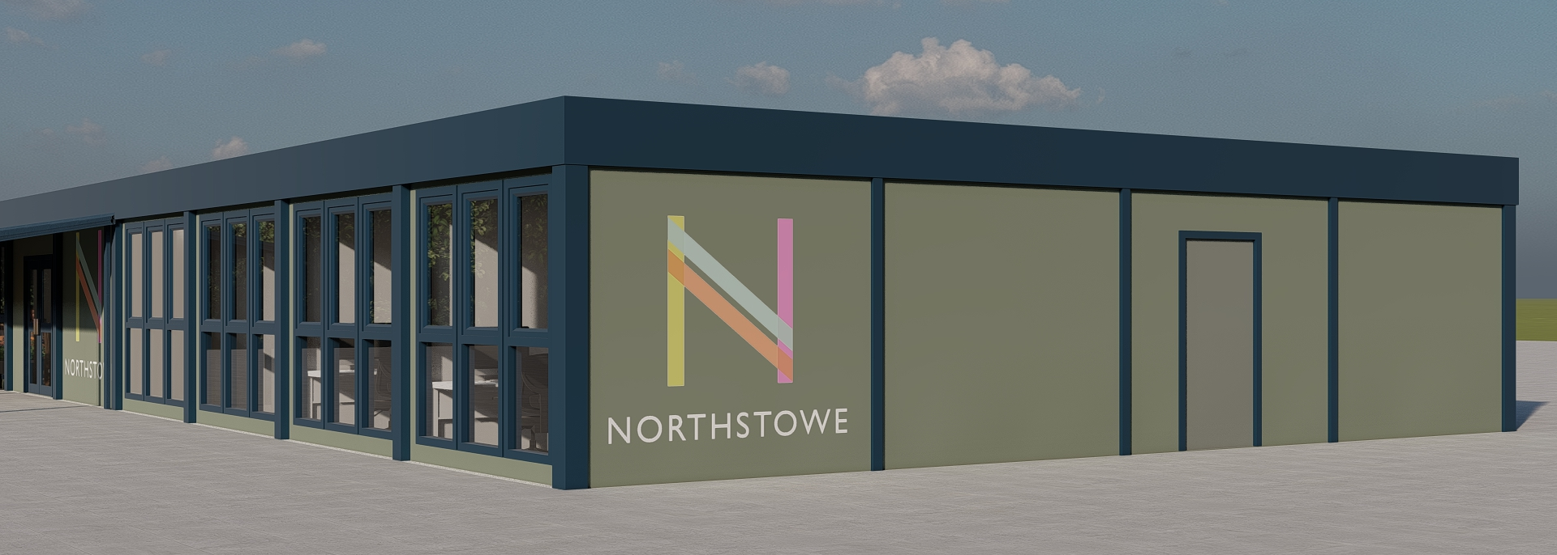
building specification

Slide 5
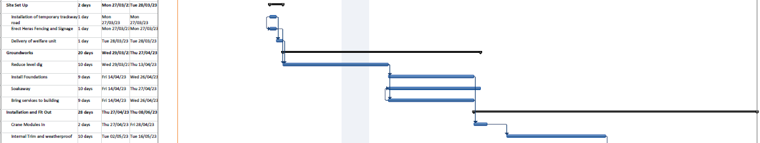
Additional Information
Snap shot of the indicative projects programme, some dates may vary.
Site set up has already completed.
Works on digging out the building location and preparing for foundations will continue for approximately 19 days.
Installation of the building modules proposed for 27th April.

