Slide 1
Northstowe Phase 2 and 3 Update
Dean Harris and Emma Brown
Notes:
.

Slide 2
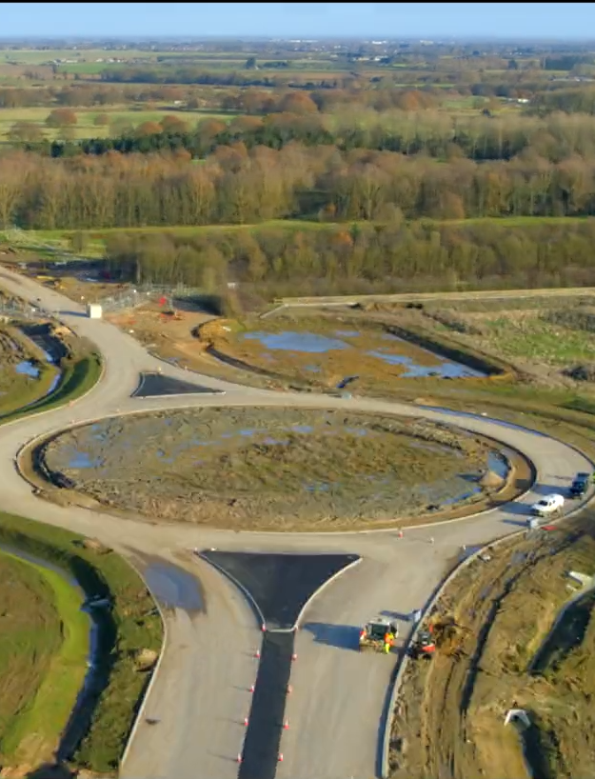
Strategic Infrastructure Opening
Phase 2 Southern Access Road West and Water Park are now scheduled to open by July 2023.
Delays have been caused by a number of factors including footpath failure issues and climatic conditions.

Slide 3
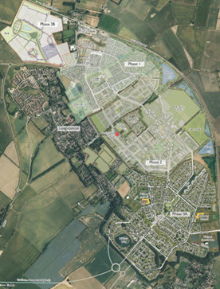
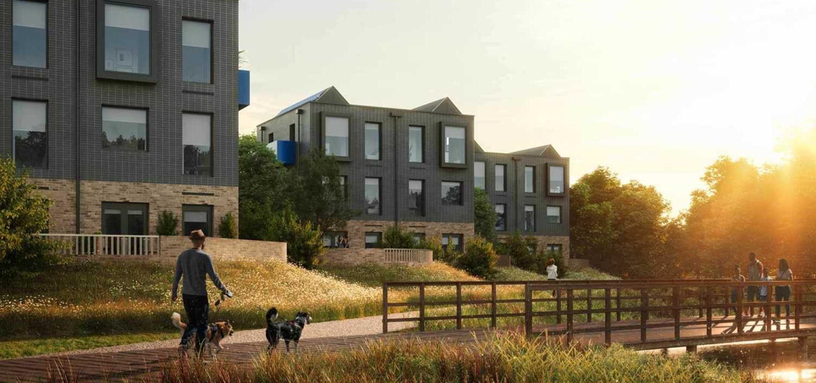

Phase 2A Remarketing
Following House by Urban Splash going into administration, we have arranged for the peninsular to be completed and are shortly to commence remarketing to find a new development partner.

Slide 4
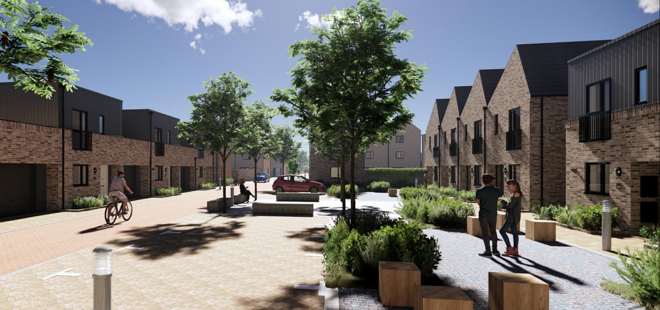
Phase 2b – Keepmoat (300 homes)
Keepmoat are now on site and will be delivering 300 homes

Slide 5
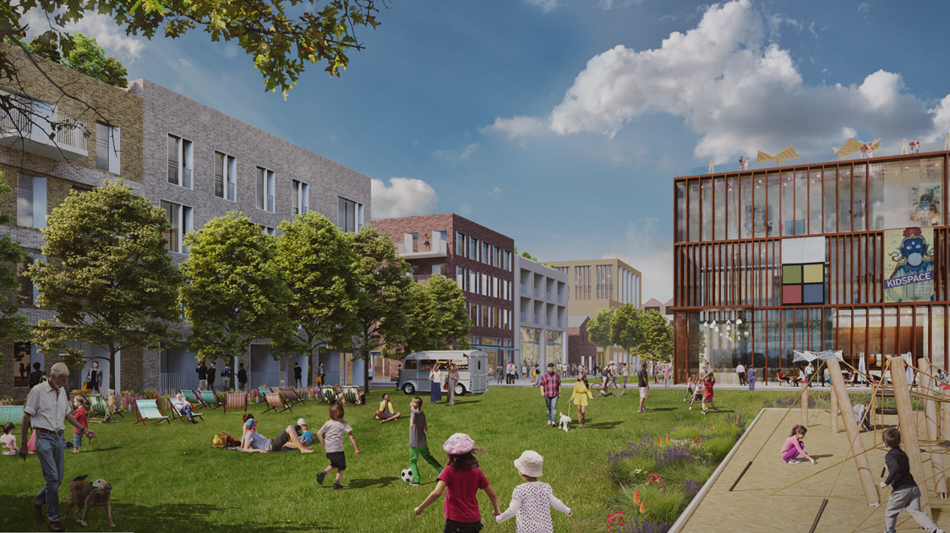
Northstowe Town Centre ‘Central One'
Our development partner is working up proposals for Central One which will deliver initial town centre facilities and over 500 homes.
Central One will include a site for the Civic Hub which will include space for health facilities.

Slide 6
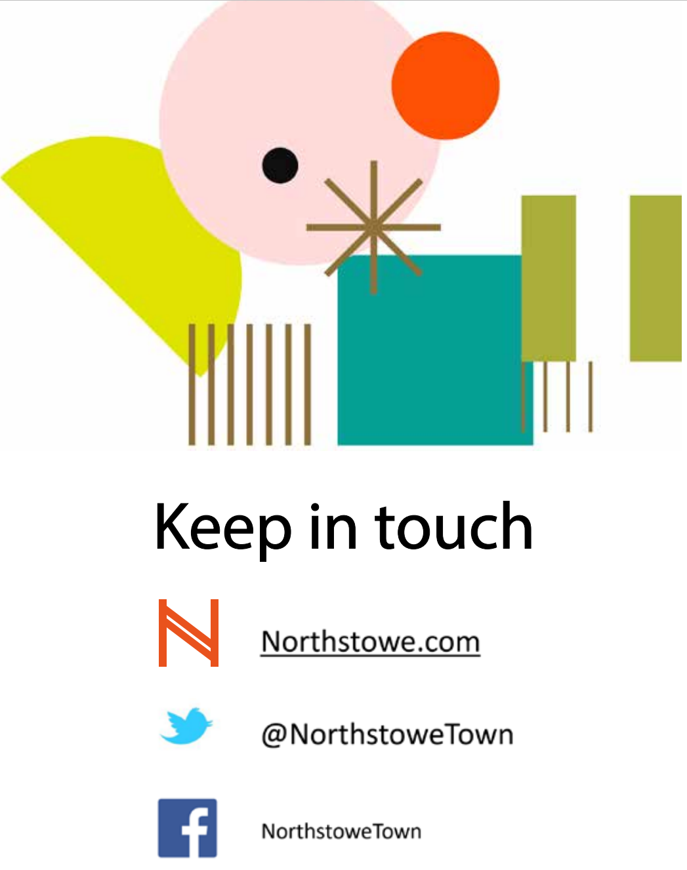
Notes:
We're also working on a delivery strategy to achieve a pipeline of 5000 homes. Our consultants have commenced work on designing the Eastern Sports Hub (to the south of Northstowe College) and we'll bring this to a future Forum meeting.

