Slide 1
Northstowe Town Council Events and Markets Committee
NORTHSTOWE MARKET UPDATE
CllrCarla Bros Sabria
Lead of market development working group

Slide 2

🞄 Delay in delivery of local centre has resulted in lack of both community and shopping facilities
Why a market?
🞄 Promote healthy and environmentally friendly shopping habits
🞄 Support local businesses
🞄 +550 responses to community market survey in February 2022 – 96% said yes!
🞄 Based on responses to survey – we planned how the
pilot for regular market should be

Slide 3
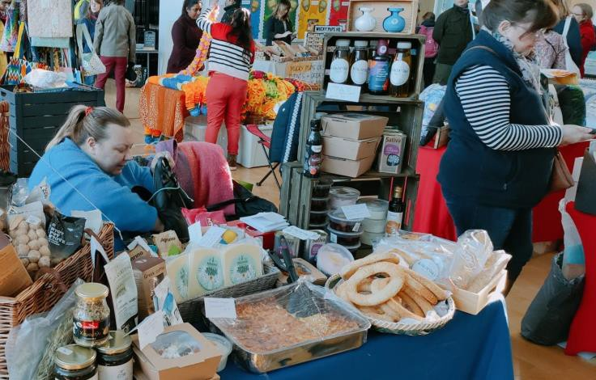

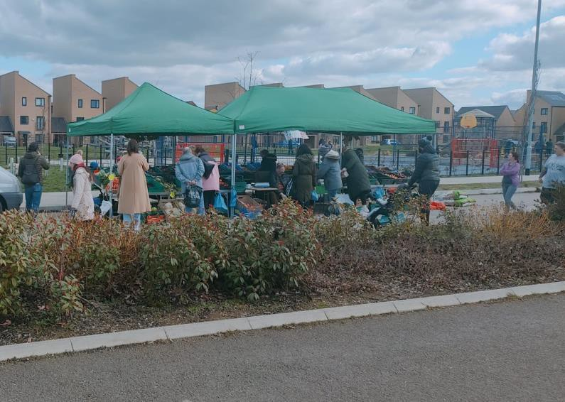
🞄 Food and non-food stalls, indoor, outdoor and coffee truck
🞄 Great attendance (+650, 12 stalls; +700, 22 stalls, March ???)
🞄 Positive feedback from traders
🞄 +35 traders registering interest
What have we done so far?
3 indoor market events

Slide 4
What’s in
progress
Regular market (PILOT)
🞄 Start 15th April
🞄 Pilot for 6 months
🞄 Weekly Sundays mornings at the Green
🞄 Phase 1 (volunteer run)
🞄 Small number of stalls selling food, focus on daily basics
🞄 Monthly indoor markets with greater variety of food and non-food and craft stalls
🞄 Phase 2 (market manager – not before August)
🞄 Expansion of weekly outdoor market to have more variety
of stalls frequently

Slide 5
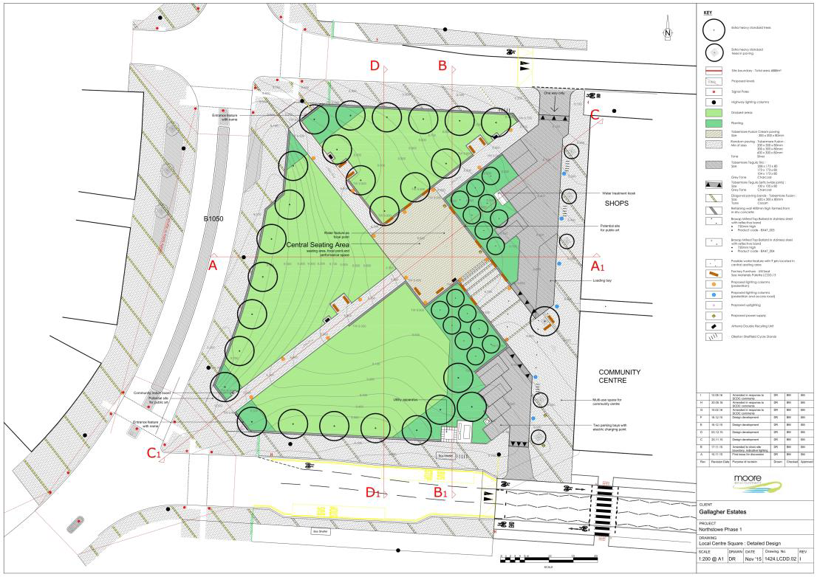

What’s in
progress
Regular market (PILOT)
🞄 Phase 2 (market manager – not before August)
🞄 Expansion of weekly outdoor market to have more variety of stalls frequently
FT
FOOD TRUCK
1
3X3 size pitch

Slide 6

Contact us
markets@northstowetowncouncil.gov.uk

Slide 7
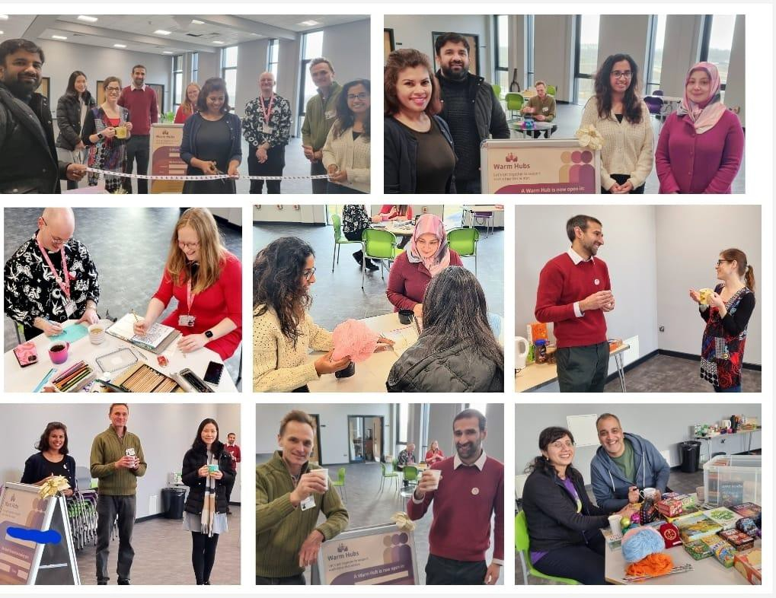

Warm Hub Northstowe
Northstowe got funding from CACRE to start the warm hub in December 2022
Warm-Hub Started on 4th January 2023
Warm hub operates on Wednesday mornings from 9:30 am – 12:30 and Thursday evenings from 6:00 pm – 8:00 pm at Northstowe Secondary School on 2nd Floor Gym area.
Community room is booked on ad hoc basis
for Well-being sessions.

Slide 8
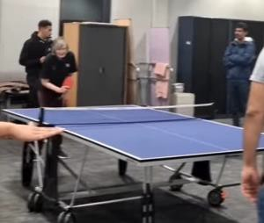
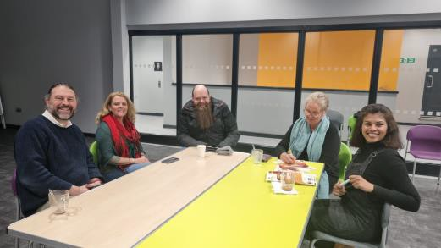
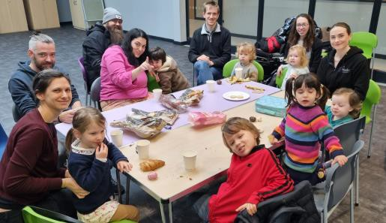
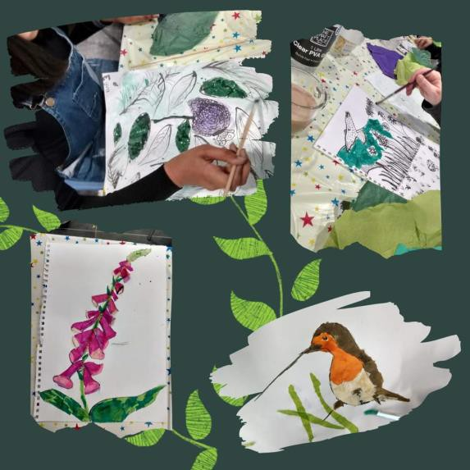
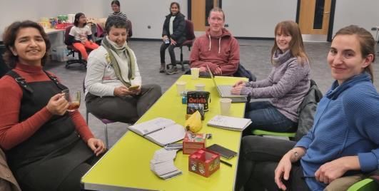
Activities at the Warm Hub
Board Games - Donated by Northstowe Gamers
Coloring and knitting - materials donated by
Michele
Table tennis – Run by Ioana
Language Café – Initiated by Mihaela
Yoga run by Vishnu
Well-being walk to the warm-hub

Slide 9
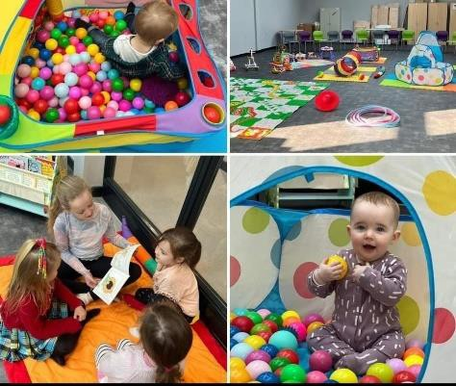
Half Term Activity
Hannah from Stardust Dance Academy organized a play session with dance and activities for kids
Had more than 100 attendees at the warm hub during the half term break in February.

Slide 10
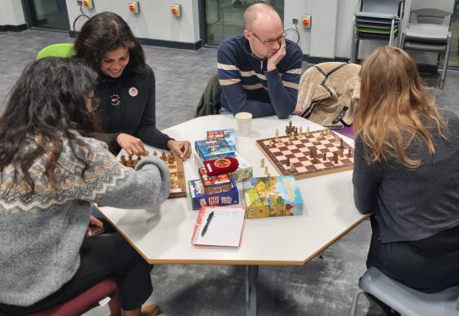
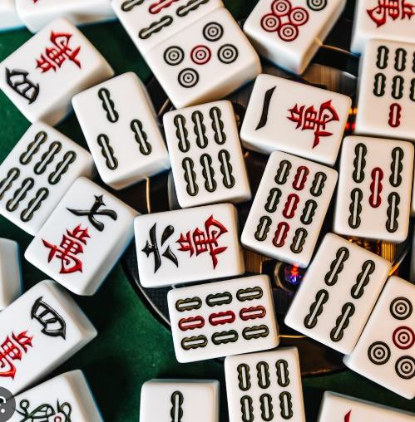
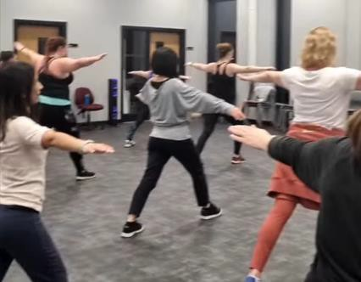
New Groups formed
Chess Club run by Ioana
Dance tasters run by volunteers
Language Café initiated by Mihaela
Well-being sessions run by volunteers
Mahjong club initiated by Jo

Slide 11
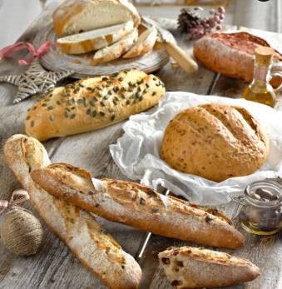

Free Refreshments
Volunteers from Sustainability Northstowe collects food from Community larder
Free refreshments are provided at the warm hub
Residents donate refreshments

Slide 12

Future of the Warm Hub
Funding has been approved from CACRE to run the warm hub for the next 2 months.
TC is still in discussion with Northstowe Hub on managing the warm hub going forward.

Slide 13

Request for volunteers
Warm hub is struggling to find volunteers for Wednesday Mornings.
Signup Genius has been set up for volunteers to
register
Contact townclerk@northstowetowncouncil.gov.uk or Cllr.Delip@northstowetowncouncil.gov.uk

Slide 14
Thank you

Slide 15

Northstowe Town Council
THE TOWN COUNCIL - LOOKING FORWARD
Cllr RichardOwen Town Mayor

